Slide 1


IMPLEMENTATION OF IP SPOOFING
By: Gitisha Soni

Slide 2







IP SPOOFING

Slide 3







Definition
IP spoofing is a technique used to disguise the identity of a sender by altering the source IP address in network packets.
Purpose
IP SPOOFING
Often used in cyberattacks such as DDoS (Distributed Denial of Service) to overload systems or bypass security measures.
How It Works
The attacker manipulates packet headers to appear as if they are coming from a trusted source.

Slide 4


Common Attacks
DDoS Attacks – Floods a target with fake requests.
Man-in-the-Middle (MITM) Attacks – Intercepts communication.
Session Hijacking – Gains unauthorized access to user sessions.
IP SPOOFING
Prevention Measures
Implement packet filtering.
Use authentication mechanisms.
Enable network monitoring tools

Slide 5
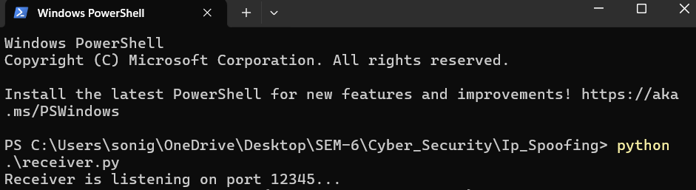
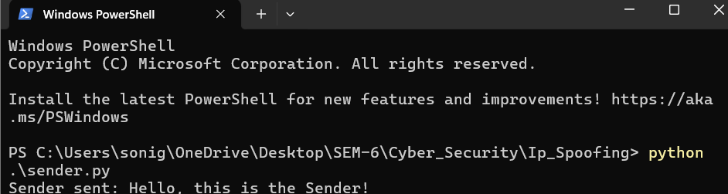
HOW IT IS DONE

Slide 6
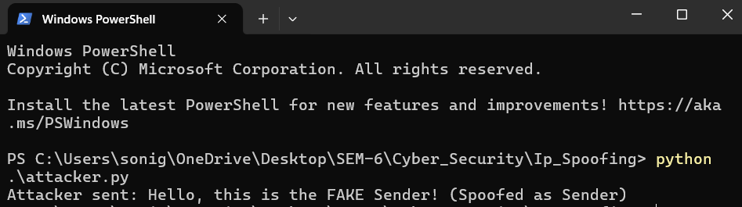
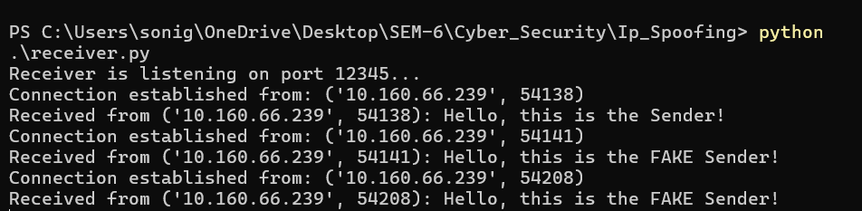

Slide 7





TOOLS USED
Kali Linux
Wireshark
Windows (Victim)
Python (Scapy)
VMWare Workstation

Slide 8






NETWORK SETUP
Kali and Windows must be in the same network.
Use ipconfig (on Windows) and ip a (on Kali) to confirm IPs
Enable ping between them (test with ping <windows_ip>)

Slide 9
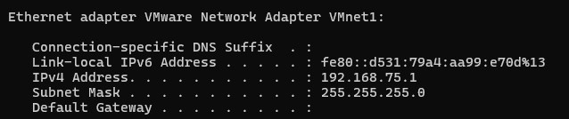
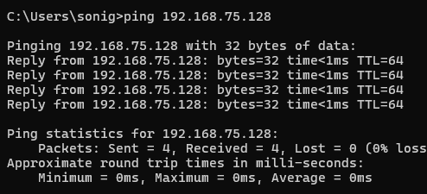
CONNECTION SETUP
07

Slide 10
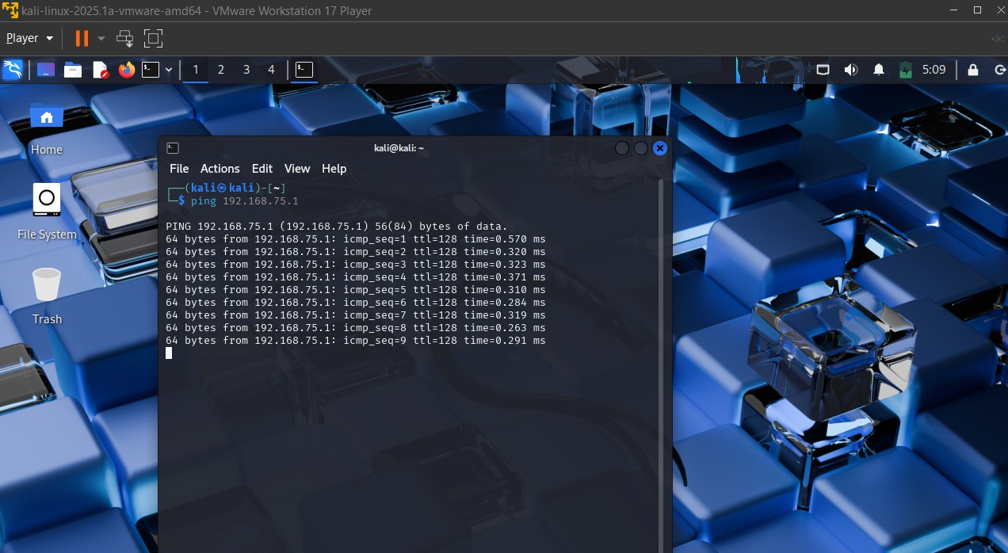

Slide 11
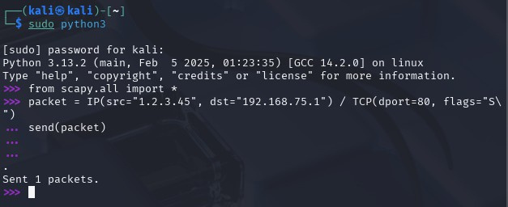

CODE:
03

Slide 12

SIMULATION
03

Slide 13
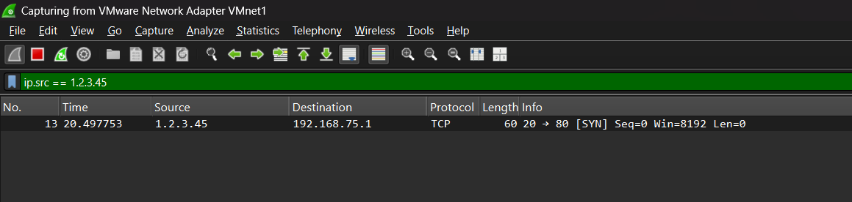
SIMULATION
03

Slide 14
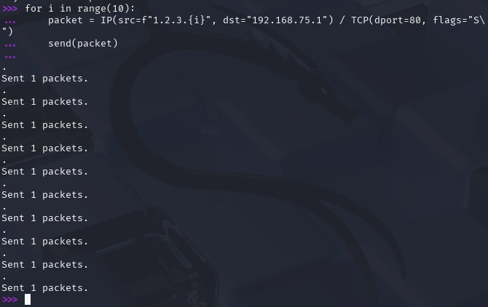
SENDING MULTIPLE PACKETS

Slide 15
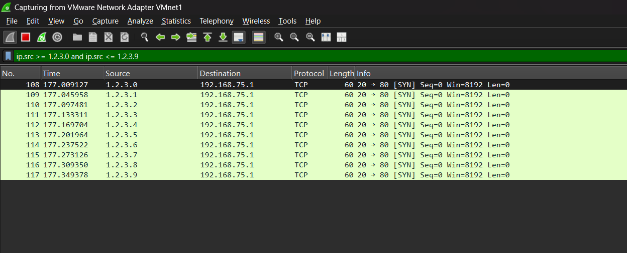
SIMULATION

Slide 16
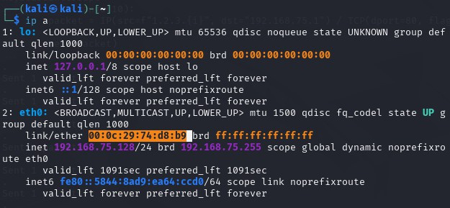
MAC ADDRESS OF KALI

Slide 17
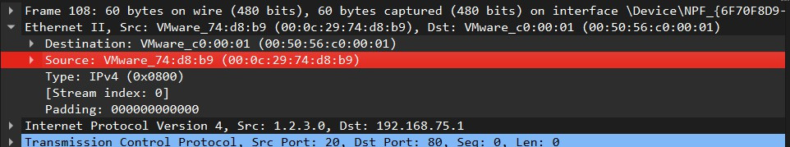
CHEKING SENDER’S MAC ADDRESS

Slide 18
CONCLUSION
In this simulation, we successfully demonstrated IP spoofing using Scapy in Kali Linux. By crafting and sending a spoofed packet with a fake source IP, we observed that the receiver (Windows system with Wireshark) detected the packet as originating from the spoofed IP, not the attacker’s real IP.
However, by analyzing the MAC address of the incoming packet in Wireshark and comparing it with the actual MAC address of the Kali machine, we verified that the packet physically originated from Kali. This confirms that while the IP address can be spoofed, the MAC address reveals the true source on a local network.
This helped us understand how attackers can mask their identity using IP spoofing and how network-level forensics (like MAC tracking) can still trace the real sender.

Slide 19

THANK YOU !

